Slide 1


AIR FORCE ASSOCIATION’S
CYBERPATRIOT
NATIONAL YOUTH CYBER EDUCATION PROGRAM
Additional Training Topics
www.uscyberpatriot.org
© Air Force Association

Slide 2
RON WOERNER, CP-VI MENTOR OF THE YEAR, TIPS
Familiarize yourself with Microsoft Windows tools and resources
Microsoft SysInternals Suite Applications that help troubleshoot Windows issues and administer the operating system.
Windows God Mode. Windows 7 and 8 feature that allows all Control Panel and Policy functions from one folder on the desktop.
Microsoft Baseline Security Analyzer (MBSA) and Security Essentials
How to Geek School contains a number of tutorial videos on securing Windows and using SysInternals tools.
BleepingComputer Security Tutorials & Tools is another site with information and tools that will help.
Familiarize yourself with the Ubuntu Linux Operating System
The official Ubuntu Desktop Guide is available at https://help.ubuntu.com/12.04/ubuntu-help/index.html. This will help introduce you to the operating system.
Fosswire has a couple of cheat sheets. These show commands to run on a terminal / command line.
http://www.cheat-sheets.org/saved-copy/fwunixref.pdf
http://www.cheat-sheets.org/saved-copy/ubunturef.pdf
Make sure your team documents everything they do on the images
Get hands-on practice with virtual images using your MSDN account
Have students who are not “hands on” the images during competition are taking notes, doing research, and observing the students who are “hands on”
Have fun!

Slide 3
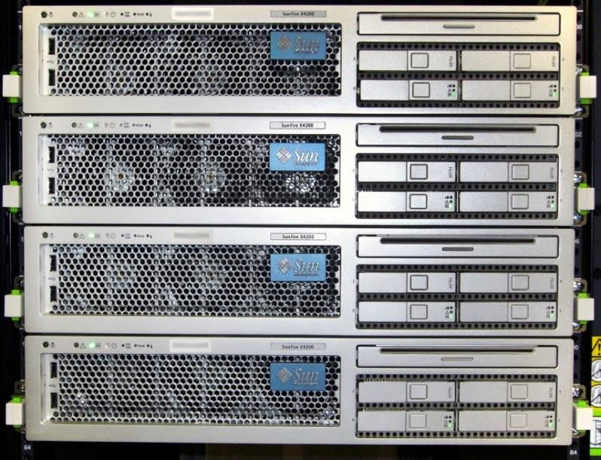
WEB SERVERS
A web server stores, processes, and delivers web pages to clients using HTTP
– Definition and diagrams of a web server: http://www.pcmag.com/encyclopedia/te rm/54342/web-server
The leading web server software is
the Apache HTTP Server
– Information on Apache: http://httpd.apache.org/ABOUT_APACH E.html
Source: http://upload.wikimedia.org/wikipedia/commons/f/f6/SunFire- X4200.jpg

Slide 4
FILE SYSTEMS
4
Windows operating systems typically use one of two file systems to organize data on hard discs
FAT32
Used in older operating systems such as Windows 95 and 98
NTFS
Modern file system currently used in Windows XP
onward
Comparison of FAT32 and NTFS: http://windows.microsoft.com/en- us/windows-vista/comparing-ntfs-and-fat-file-systems
Ubuntu Tip: Linux systems use the Ext2, Ext3, or Ext4 file systems: https://help.ubuntu.com/community/LinuxFilesystemsExplained

Slide 5
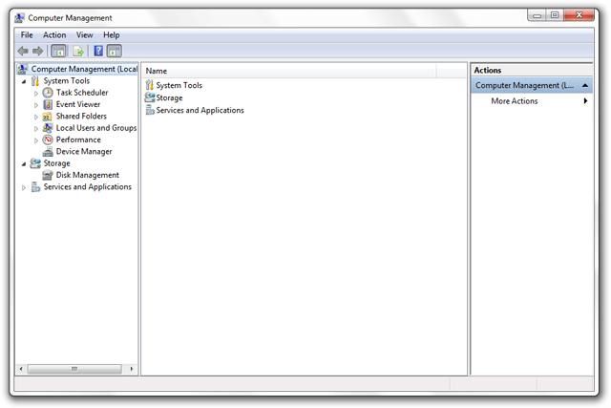
MICROSOFT MANAGEMENT CONSOLE
5
MMC is a Windows component that allows customization and configuration of a system via GUI objects called snap-ins.
Common snap-ins include:
Computer Management
Group Policy Management
Services
Performance
Event Viewer
Microsoft’s MMC guide:
http://technet.microsoft.com/en-us/library/bb742442.aspx

Slide 6
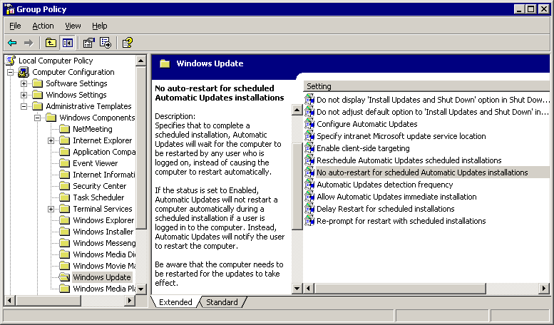
GROUP POLICY
6
Group Policy: Settings for groups of users and computers, including those regarding registry-based policy, security, computer startup and shutdown, and logon and logoff
– Details on Microsoft group policy: http://technet.microsoft.com/en- us/library/bb742376.aspx
Some useful settings may be:
Not displaying last user name on login
screen
How to: http://support2.microsoft.com/kb/310125
Requiring Ctrl Alt Del before signing on
How to:
http://support.microsoft.com/kb/308226
Source: http://blog.codinghorror.com/content/images/uploads/2005/05/6a0120a85dcdae970b0 128776fbe89970c-pi.png

Slide 7
NT LAN MANAGER (NTLM)
7
Authentication protocol
Authentication protocol confirms the identity of any user logging on to a domain or access network resources
NTLM is a Microsoft authentication protocol: http://msdn.microsoft.com/en- us/library/windows/desktop/aa378749(v=vs.85).aspx
Password hashing
Method of taking a variable-length password and creating a cryptic, fixed-length password from it
Details on password hashing: http://security.blogoverflow.com/2013/09/about- secure-password-hashing/
LanMan Hash is a password hashing function of NTLM
Details on the security risk of LanMan Hash:
http://www.microsoft.com/security/sir/strategy/default.aspx#!password_hashes
Ubuntu Tip: Ubuntu 8.10 and later use salted SHA-512 based password hashes: https://wiki.ubuntu.com/Security/Features

Slide 8
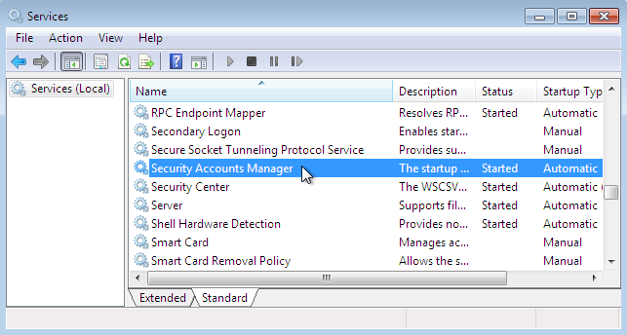
SECURITY ACCOUNT MANAGER (SAM)
The Security Account Manager (SAM) is a Windows database that stores user accounts and security descriptors for users on the local computer
Information on the SAM:
http://searchenterprisedesktop.techtarget.com/definition/Security-Accounts-
Manager
Possible security issues: https://technet.microsoft.com/en- us/library/security/ms14-016.aspx
Source: http://computerstepbystep.com/wpimages/wp8863e5cd_01.png

Slide 9
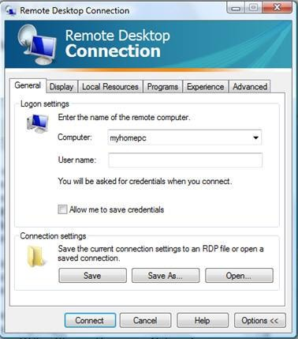
SHARING SYSTEMS AND REMOTE CONNECTIONS
Remote connections are ways of sharing systems.
Examples:
Virtual Network Computing (VNC)
VNC allows you to share and give control of your
desktop to another user
VNC variants and applications:
http://ipinfo.info/html/vnc_remote_control.php
Remote Desktop
Similar to VNC, Remote Desktop Protocol (RDP), allows a
user to control a remote system
Using RDP: http://windows.microsoft.com/en-us/windows/connect- using-remote-desktop-connection#connect-using-remote-desktop- connection=windows-7
Source: http://blog.tmcnet.com/blog/tom- keating/images/remote-desktop-general-tab.jpg
Ubuntu Tip: If using a Gnome desktop, Remote desktop is easy in Ubuntu: http://www.makeuseof.com/tag/ubuntu-remote-desktop-builtin-vnc-compatible- dead-easy/

Slide 10
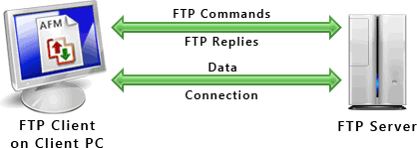
FTP, TFTP, AND SFTP
1
0
The File Transfer Protocol (FTP) is a standard network protocol used to transfer computer files from one host to another over the Internet
FTP FAQ: http://windows.microsoft.com/en-us/windows-vista/file-transfer-protocol- ftp-frequently-asked-questions
Secure File Transfer Protocol works similarly to FTP but is more secure
How to use SFTP: https://www.digitalocean.com/community/tutorials/how-to-use- sftp-to-securely-transfer-files-with-a-remote-server
Trivial File Transfer Protocol (TFTP) is a simplified version of FTP
Details on TFTP: http://compnetworking.about.com/od/ftpfiletransfer/g/tftp-trivial-
file-transfer-protocol.htm
Source: http://www.deskshare.com/resources/articles/images/ftp-protocol.gif

Slide 11
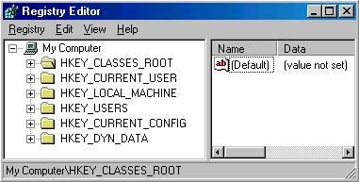
WINDOWS REGISTRY
The registry is a hierarchical database that stores configuration settings and options
WARNING: If you do not know what you are doing, editing the registry can cause serious problems that may require you to reinstall Windows
Explanation of the registry and how to make edits: http://pcsupport.about.com/od/termsr/p/ registrywindows.htm
Managing remote access to the registry: http://support2.microsoft.com/kb/314837
Source: http://www.computerhope.com/reg1.gif
Ubuntu Tip: There is no registry in Ubuntu per se, but if using a GNOME desktop, dconf is similar: https://wiki.gnome.org/action/show/Projects/dconf?action=show&redirect=dconf
11

Slide 12
WINDOWS COMMAND PROMPT
12
Like Linux, the command line in Windows allows you to enter commands without a GUI.
Sample commands are:
Ipconfig is used to view or modify a computer’s IP addresses
Bcedit is used to view or make changes to Boot Configuration Data
Cmd starts a new instance of the command line interpreter
Convert is used to change FAT32 formatted volumes to NTFS
Nslookup is used to display the hostname of an entered IP address
Opening the command prompt: http://windows.microsoft.com/en- us/windows-vista/open-a-command-prompt-window
Detailed list of commands: http://pcsupport.about.com/od/commandlinereference/tp/windows-7- commands-p1.htm

Slide 13
PORTS AND PROTOCOLS
13
TCP/IP is a set of communication protocols
Transmission Control Protocol (TCP) provides reliable, ordered, and error-checked
delivery of data
User Datagram Protocol (UDP) uses a simple connectionless transmission model
TCP/IP applications send data to specific ports to help computer systems understand what to do with the data that flows into them,
Examples of c
Service | Protocol | Port
FTP | TCP | 20, 21
TFTP | UDP | 69
HTTP | TCP | 80
HTTPS | TCP | 443
RDP | TCP | 3389
ommon ports a
nd protocols:
Open ports can be a security risk by allowing attackers into your system
Firewalls typically block unnecessary ports, but it is unwise to blindly rely on one
Information on determining which ports are open and which should be closed: http://www.techrepublic.com/article/lock-it-down-develop-a-strategy-for- securing-ports-on-your-servers/

Slide 14
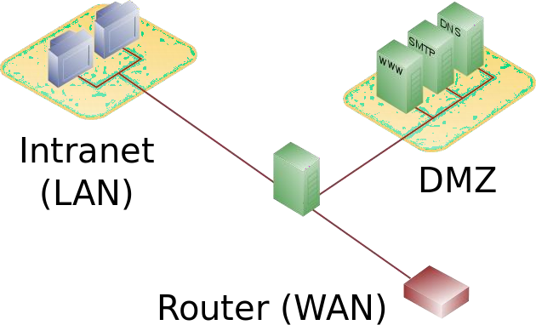
DEMILITARIZED ZONE (DMZ)
14
A DMZ acts as a gateway to the public internet that acts as an
additional layer of security to an organizations local area network
– An external attacker only has direct access to equipment in the DMZ
A typical DMZ may look like the following (the unlabeled green icon in the center is a firewall):
Source: http://en.wikipedia.org/wiki/DMZ_(computing)#mediaviewer/File:DMZ_network_diagram_1_firewall.svg

Slide 15
DISTRIBUTED COMPONENT OBJECT MODEL (DCOM)
DCOM is a technology for communication among software
components distributed across networked computers
In depth information on DCOM: https://www.princeton.edu/~achaney/tmve/wiki100k/docs/ Distributed_Component_Object_Model.html
Mitigating DCOM Vulnerabilities: http://technet.microsoft.com/en-us/library/dd632946.aspx
15

